Slide 1
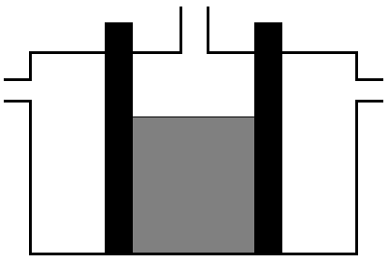
Fuel Cell
anode
cathode
?
?
H₂
O₂
?
Potassium
Hydroxide
Solution
OVERALL EQUATION
Click on labels and ?s for further information

Slide 2
ANODE
POROUS CARBON
WITH NICKEL (CATALYST)
2H₂ (g) +4OH⁻ (aq) → 4H₂O (l) + 4e⁻
Half Equation

Slide 3
CATHODE
POROUS CARBON
WITH NICKEL & NICKEL OXIDE (CATALYST)
O₂ (g) + 2H₂O (l) + 4e⁻ → 4OH- (aq)
Half Equation

Slide 4
OVERALL EQUATION
2H₂ (g) + O₂ (g) → 2H₂O (aq)
about 70% efficiency

